Slide 1


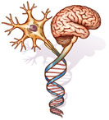
Dr. Demitre Serletis, BSc, MD
FRCSC Candidate, Neurosurgery
PhD Candidate, Physiology/Biomed. Eng.
University of Toronto, Canada

Slide 2
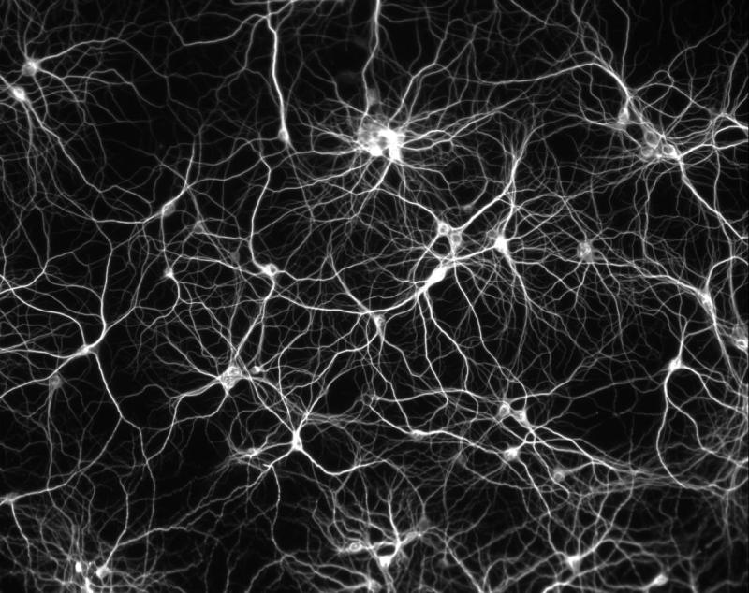
OUTLINE
Background
Experimental Methods
Results and Interpretation
Future Directions

Slide 3
BACKGROUND
Terminology:
  Noise: Fluctuations, oscillations, variability
  Often confused with stochasticity (randomness)
  In the real world:
    Undesirable disturbances distinct from any meaningful signal, but potentially capable of distorting/masking that signal
Notes:
To date, noise in the nervous system has been referred to in vague and ambiguous terms, including…

Slide 4
Definition – Neuronal noise:
  Subthreshold, time-varying, random-like fluctuations in electrical membrane potential
    Ubiquitous throughout the nervous system
  Distinct from action-potential (i.e. spiking) dynamics
Conceptually:
  Background context to more obvious spike-related events in the foreground (i.e. APs, bursts and seizures)
  “Traveling […] waves that we see as gentle ripples in calm water, [on top of whose] crests much larger electrical events known as action potentials may be evoked”
  Llinás, I of the Vortex (2001)

Slide 5
Intrinsic and extrinsic cellular sources of noise:
  Electrical noise (thermal, shot)
  1/f noise
  Synaptic activity
    65% of noise in CA1 pyramidal neurons (Wahl et al, 1997)
  Gap junctions
  Fluctuations in ionic membrane conductance
Notes:
Noise captures the integrated dynamical activity of different intrinsic/extrinsic sources

Slide 6
Importance of studying fluctuations:
  Noise increases neuronal computational ability
    ‘Stochastic resonance’ -- Noise enhances detectability of weak signals that would otherwise never reach threshold (Rudolph & Destexhe, 2001; Stacey & Durand, 2001)
  Background cellular activity reflects dynamics in the network
    Tight correlations between intracellular activity in neocortical neurons and macroscopic EEG recordings (Rudolph et al, 2004)
    Correlational structure of neuronal noise in the brain has been implicated in population coding at the local network level (Averbeck, Latham & Pouget, 2006)
  Noise has been implicated in mechanisms of seizure initiation
    State transitions in a bifurcation paradigm were directly found to be induced by network noise (Takeshita, Sato & Bahar, 2007; Suffczynski, Kalitzin & Lopes da Silva, 2004)
Notes:
These findings underscore the important role of noise (i.e. fluctuations) in brain dynamics

Slide 7
Research Question:
  Whether fluctuations contain specific deterministic or stochastic features (sources) that vary from state to state
    May be tracked over time to classify, identify and potentially predict future brain state transitions
      e.g. Sleep states, epileptiform activity, etc.
Hypotheses:
  1) Fluctuations contain specific sources that change during transitions from one brain state to another
  2) These sources are detectable at the cellular, local network and global (EEG) levels
  3) They may be characterized using deterministic and stochastic methods
Notes:
This approach may identify unique components within an otherwise complex signal that may be tracked …

Slide 8
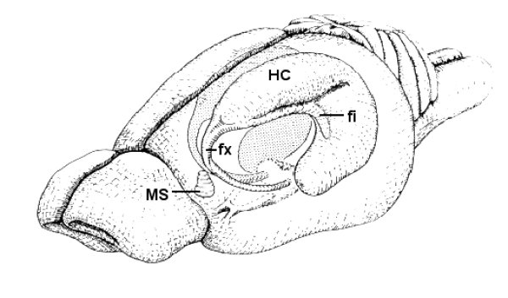
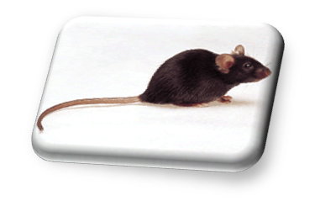

Experimental Methods
Whole-intact hippocampal preparation:
  Male C57/BL mice (age P8-14)
  Advantages:
    Preservation of 3-D architecture
    Avoids damage to superficial neurons and local circuitry

Slide 9
Data acquisition:
  Voltage recordings from patch-clamped CA1 and CA3 stratum oriens interneurons under current clamp
    Coordinate large populations of pyramidal cells
    Larger dendritic areas - Integration of dynamical inputs
  Membrane potential ~ -60 mV (i.e. subthreshold)
  Sampling - 10 kHz; Low-pass filter - 1 kHz
  Data collection ~ 5 min duration recordings
  Temperature 31.5 ± 0.5◦C
Notes:
Interneuron recordings of fluctuating dynamics may better capture the ongoing activity in the system

Slide 10

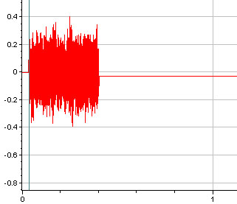
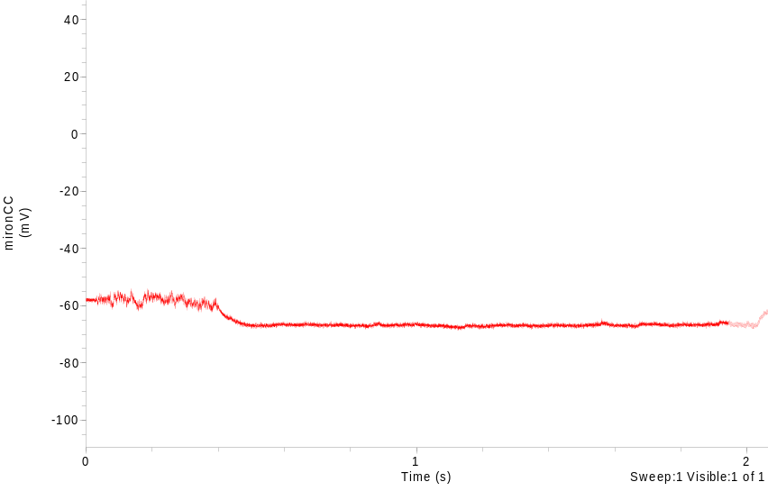
Experimental Protocol:
  CA1 and CA3 interneurons subjected to:
Synaptic
Blockers
ACSF
Synaptic + Gap
Junction Blockers
ACSF
Washout
Gap
Junction
Blocker
Drugs:
Synaptic Blockers:
CNQX (0.010 mM)
DL-APV (0.060 mM)
Gabazine (0.010 mM)
Gap Junction Blocker:
1-Octanol (0.30 mM)
Carbenoxolone (0.10 mM)
*Oleanolic Acid (0.10 mM)
    Current pulse (I-V curve)
    Subthreshold noise (chirp) injection
      Gaussian White Noise
      400 ms duration impulse
      ~ 1 nA amplitude
Noise Injection
Time (s)
-60 mV
Neuronal Output
Time (s)

Slide 11
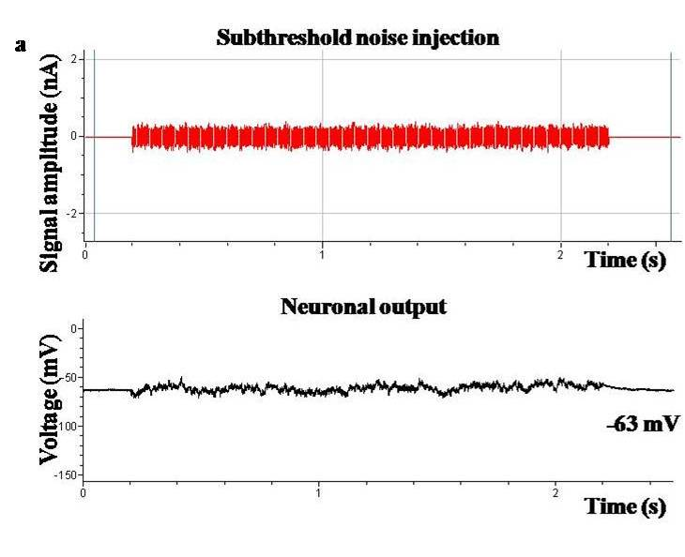
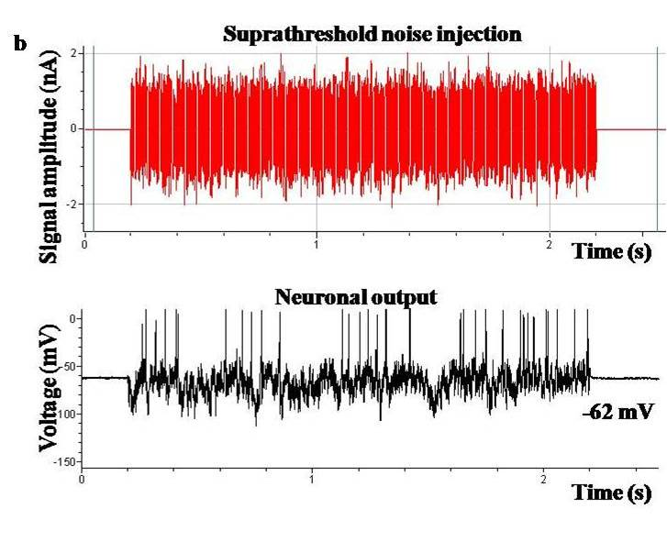
Subthreshold (1 nA)
Suprathreshold (5 nA)

Slide 12
Data analysis:
  Physiological measures
    Input resistance
  Neurodynamical measures:
    Deterministic
      Correlation Dimension
    Stochastic
      1/f ^{γ} noise structure
  Neuroengineering methods:
    Kernel computational analysis
      Laguerre Expansion Technique
    Principal Component Analysis
  Signal Analysis methods:
    Power Spectrum Analysis
    Continuous Wavelet Transform (CWT)
Notes:
Temporal frequency distributions; decomposes signal into time and frequency

Slide 13
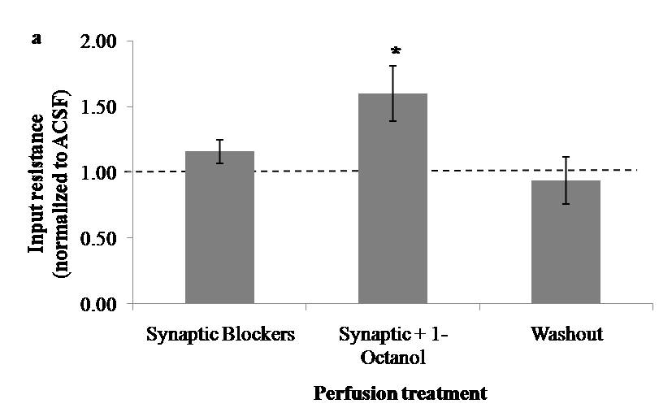
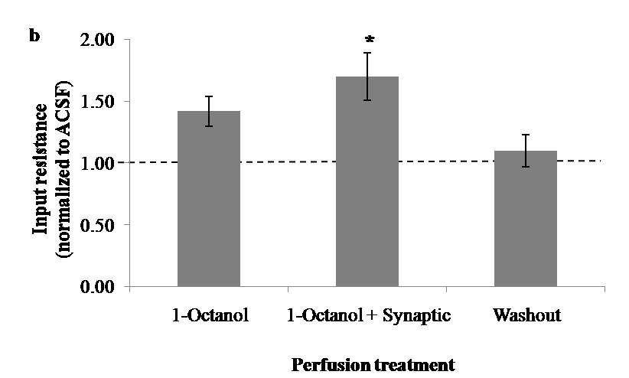
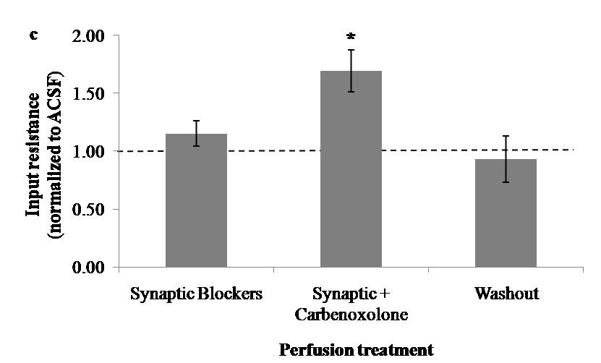
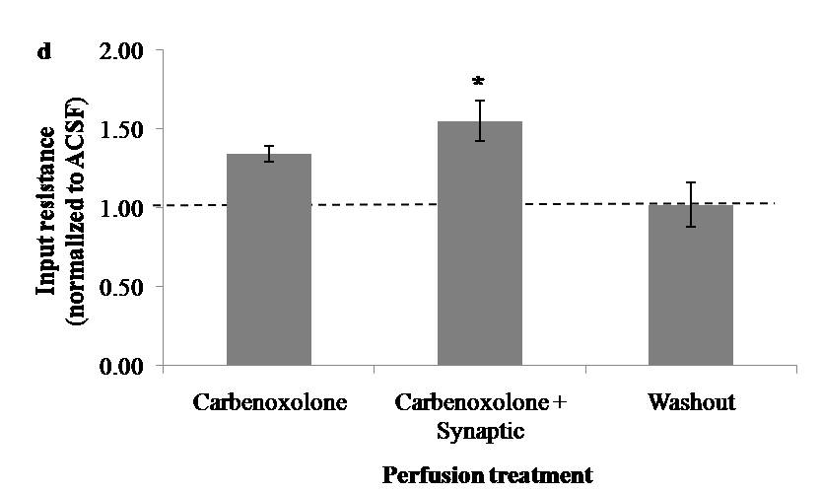
Results and Interpretation
Input Resistance
n = 14
n = 11
* P=0.031
* P=0.009
1-Octanol
n = 8
n = 12
* P=0.033
* P=0.007
Carbenoxolone
Notes:
CA3 interneurons; Protocol using either 1-octanol OR carbenoxolone (Similar findings reported for CA1)

Slide 14
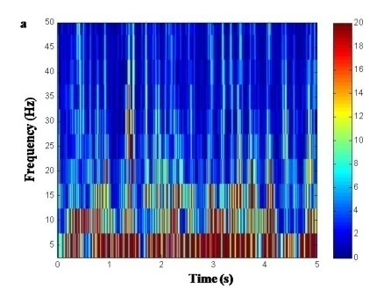
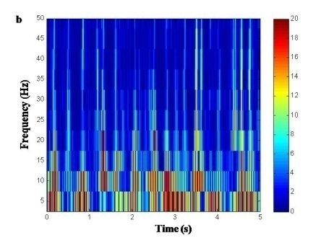
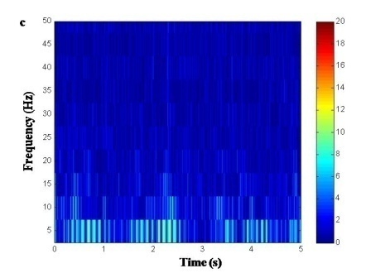
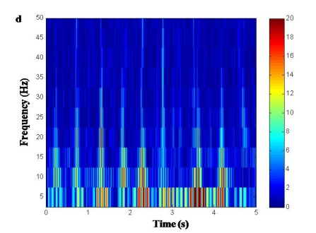
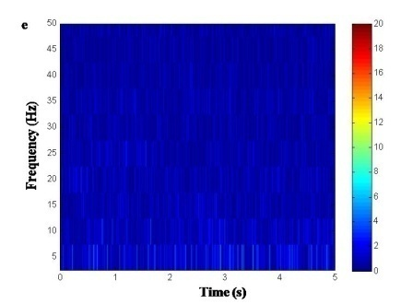
Continuous Wavelet Transform
ACSF
1-Octanol
1-Octanol + Syn
Washout
Background
Notes:
Conclusions: 1) Signal power is increased across the entire frequency spectrum compared to baseline control signals (recorded with the electrode withdrawn from the cell), confirming the fluctuations’ physiological origin as arising from the cell as opposed to the background; and 2) Signal power may be reversibly suppressed across the low-frequency range (i.e. up to 100 Hz) following synaptic and/or gap junction blockade, implicating the contribution of these physiological correlates in fluctuating dynamics.

Slide 15
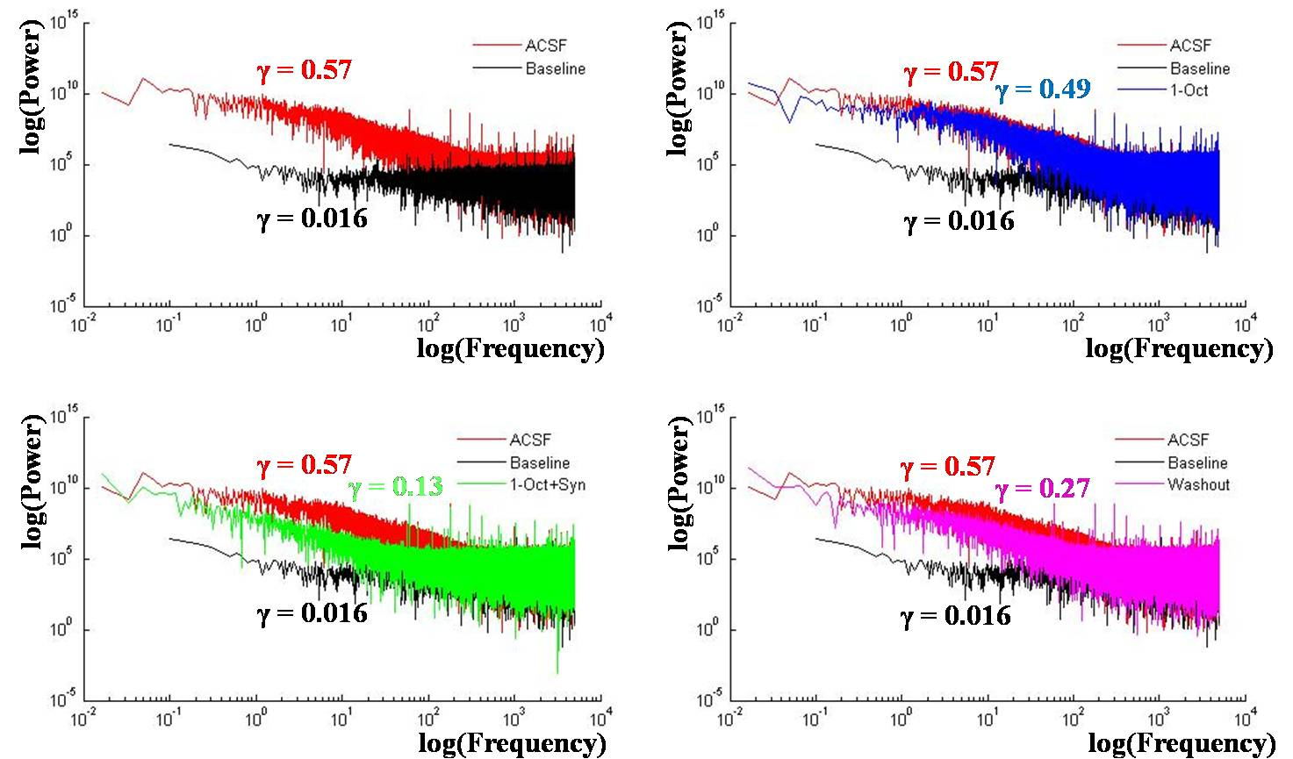

Power Spectral Analysis
1-Octanol
1-Octanol + Syn
Washout
Notes:
CA3, Syn then 1-Octanol

Slide 16
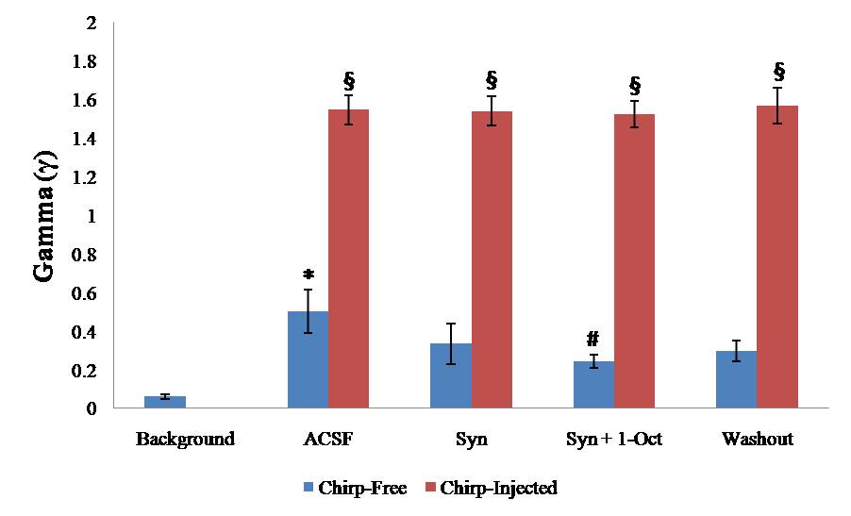
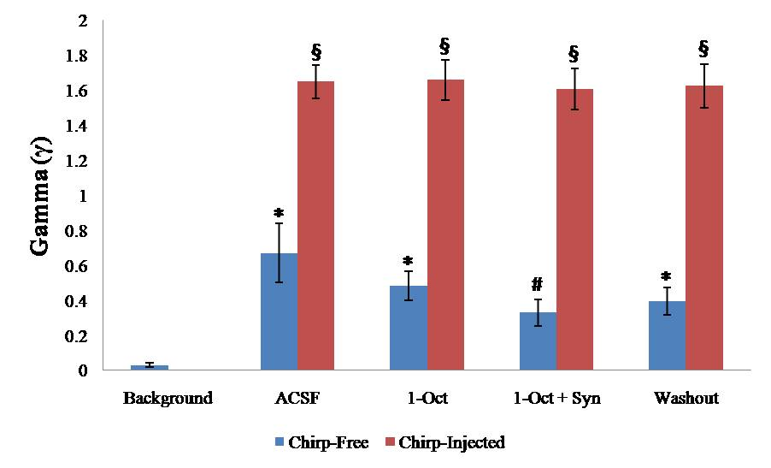
1/f ^{γ} Noise Structure
n = 14
* P<0.001 (Compared to Background)
# P=0.048 (Compared to ACSF)
§ P<0.001 (Compared to chirp-free)
1-Octanol
* P<0.001 (Compared to Background)
# P=0.043 (Compared to ACSF)
§ P<0.001 (Compared to chirp-free)
n = 11

Slide 17
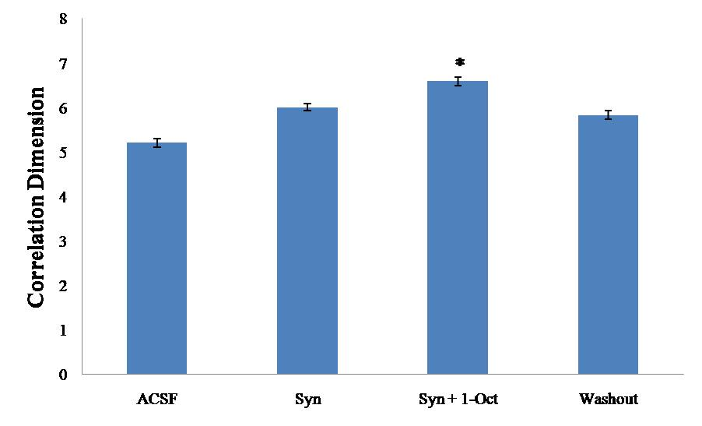
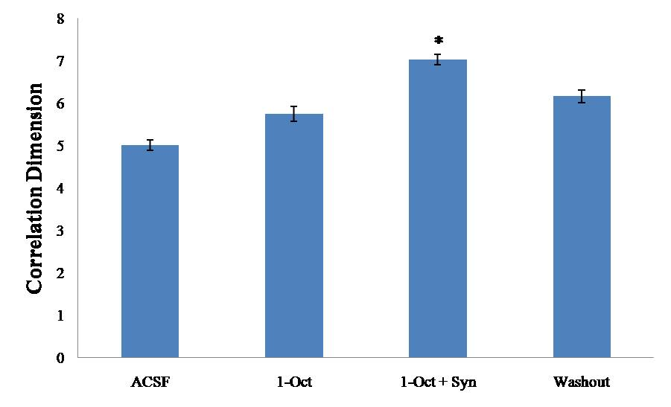
Correlation Dimension
n = 14
* P=0.005
1-Octanol
n = 11
* P=0.002
Notes:
* Compared to ACSF

Slide 18
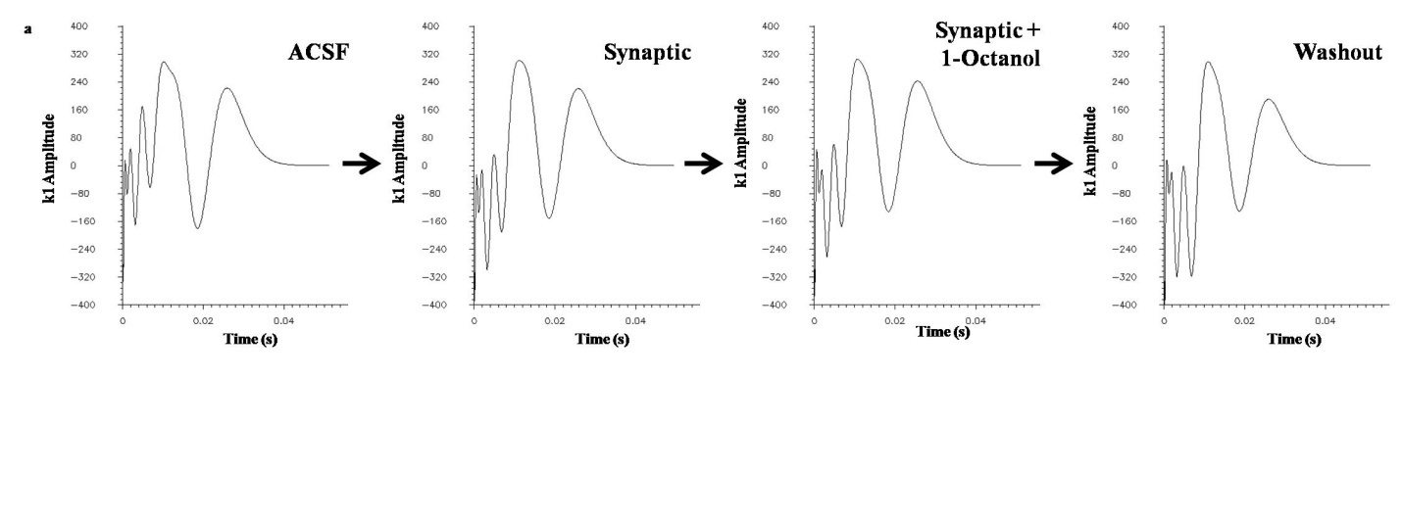
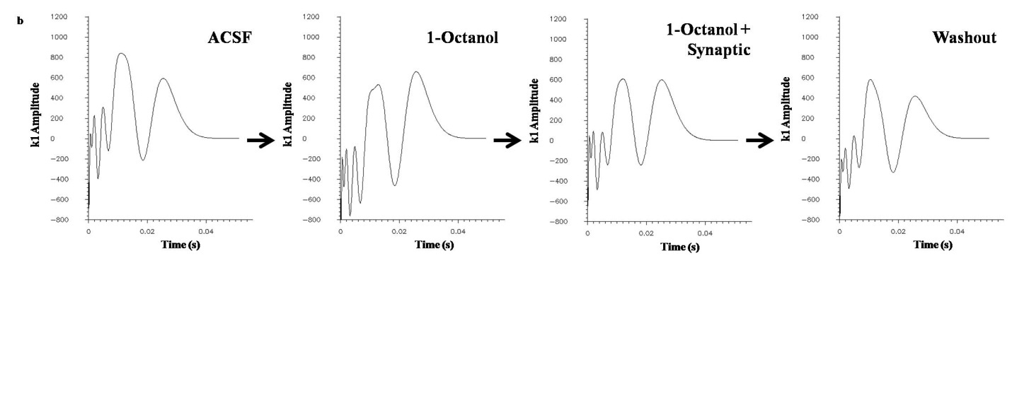
Kernel Analysis (Laguerre Expansion)
Notes:
First-order kernels denote linear, structural DC components of the cell. Stability in the first-order kernels suggests that synaptic and gap junction blockers do not interfere with the computational architecture of the interneuron, implying that changes are likely to be occurring in the higher-level kernels capturing the functional aspects of the system.

Slide 19
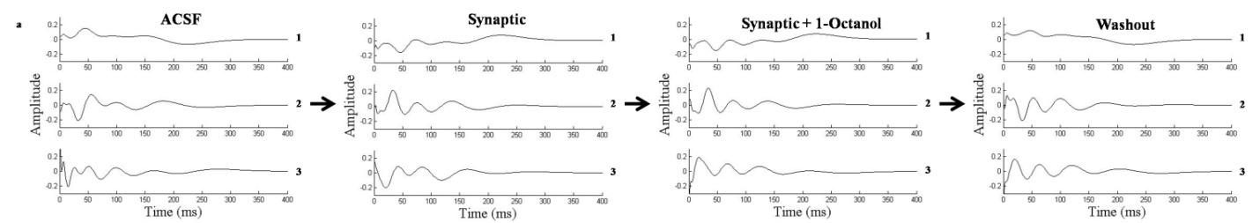
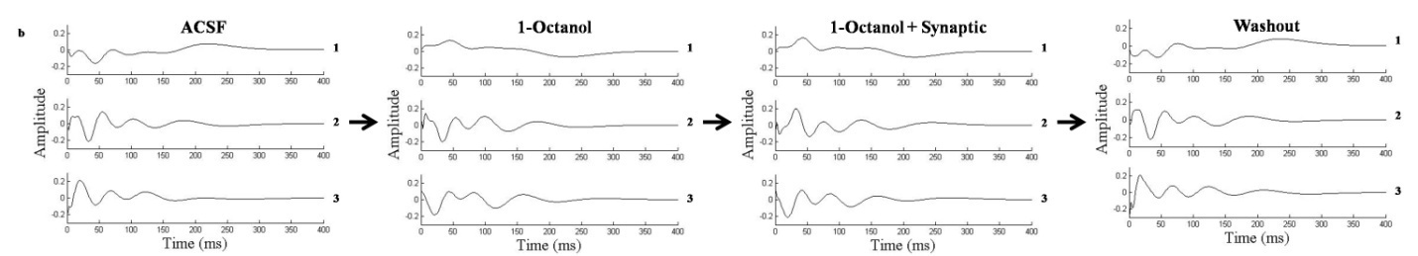
Principal Component Analysis
Notes:
1st 3 dominant neuronal modes depicting dominant signal sources that are significantly and reversibly modified by synaptic and gap junction blockade. Thus, system dynamics (reflected in the dominant modes) are intrinsically modified by pharmacological blockade in the context of a stable and unchanging system (as represented by the stable first-order kernels).

Slide 20
In Summary…
Background fluctuating dynamics:
  Are reversibly suppressed by synaptic/gap junction blockade
  Exhibit changing deterministic and synaptic properties
    Increased correlation dimension
    1/f (pink noise) → 1/f ⁰ (white noise)
  Stable 1st-order kernels
    Unchanging computational architecture of the interneuron
    Higher-level kernels capture functional features of the system
  Altered principal dynamic modes
    Functional system dynamics (reflected in the dominant modes) are intrinsically modified by pharmacological blockade in the context of a stable and unchanging system

Slide 21
Blockade eliminates “noisy” contributions from synaptic channels and gap junctions without modifying the overall structure of the system
  Potential “sources” of dynamical fluctuations
These findings implicate the contributions of synaptic channels and gap junctions in the nonlinear deterministic and stochastic properties buried within fluctuations at the cellular level

Slide 22
Future Directions
Independent Component Analysis
  Second-Order Blind Identification (SOBI) algorithm
  Investigate background fluctuations for hidden, isolated, independent sources
  Under synaptic/gap junction blockade:
    Isolate signal sources → Physiological correlates
    Deterministic + stochastic testing of isolated sources
    Computational “signature” of these components
Notes:
Hidden within the original (complex) physiological signal

Slide 23
Application to epilepsy:
  In vitro whole-hippocampus mouse model
    Low-Mg²⁺/High-K⁺ ACSF solution → Induce seizures
    Study signal sources of fluctuating dynamics during ictal and pre-/inter-/postictal periods
      Known physiological correlates (from healthy context)
    Study fluctuations at cellular level vs. local network
  Human hippocampal tissue
    Consented pts undergoing surgical treatment for epilepsy
    Lesional vs. adjacent (i.e. control) tissue
  Potential role for studying human EEG (global dynamics)

Slide 24
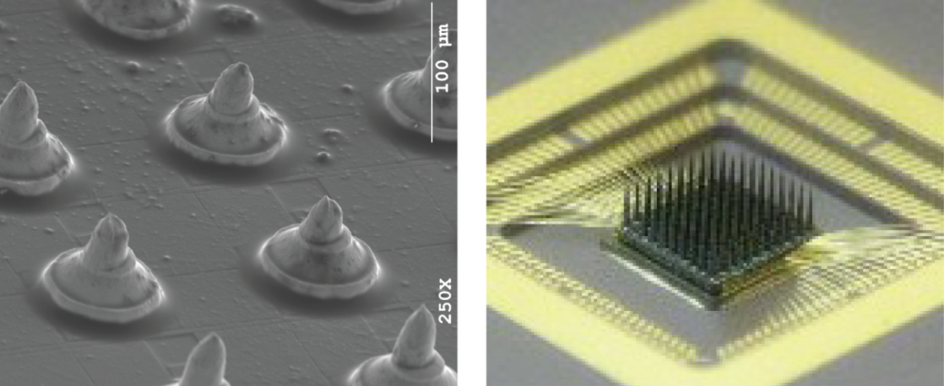
Clinical relevance:
  Track specific signal sources during brain state transitions
  Classification, identification and prediction of brain states
  In epilepsy:
    Seizure detection, prediction and possibly control
    ? Implantable therapeutic device (e.g. neurochip)
  Far-reaching implications for the treatment of epileptic patients suffering from intractable seizures
Source: Dr. Roman Genov (Electrical Eng., U. of Toronto)
Notes:
It is hoped that this approach will have far-reaching implications for the treatment of epileptic patients – an aspiration shared by all neuroscientists currently working in this field.

Slide 25
Acknowledgements
  Dr. Peter Carlen and Lab
    Dr. Damian Shin
    Dr. Miron Derchansky
    Zhang (Jane) Zhang
    Dr. Marina Samoilova
  Dr. Berj Bardakjian and Lab
    Marija Cotic
    Eunji (Ellen) Kang
    Osbert Zalay
  Dr. Taufik Valiante
  Dr. Liang Zhang
  Dr. Hon Kwan
  Division of Neurosurgery, University of Toronto (Canada)
    Surgeon Scientist Program
    Clinician Investigator Program

Slide 26

THE END

